Slide 1



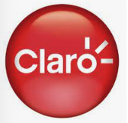
Taller Openshift
CP4 Watson AIOps
Luis Felipe Martinez, Jessica Barreto, Paola Casanova
Customer Success Manager Architect

Slide 2




Agenda
Sesión 1
Introducción - Generalidades
Sesión 2
Hands on
Hora de inicio: 9:00 am
Introducción – Rol – Información general CP4 Watson AIOPs
Contenedores/Podman/K8s
K8s Vs OCP
BREAK – 10.30 am
11:00 – 12.30 Consola Web – Despliegue Monitoreo – Acceso ambientes
ALMUERZO – 12.30 pm
Hora de inicio: 1:30 pm
Despliegue CLI
Escalabilidad de una aplicación
Break - 3.00 PM
Comandos básicos/troubleshooting
Describir pods, nodos, networking, mustgather, logs revisar aplicaciones, monitoreo
Duración: 3:00 horas

Slide 3
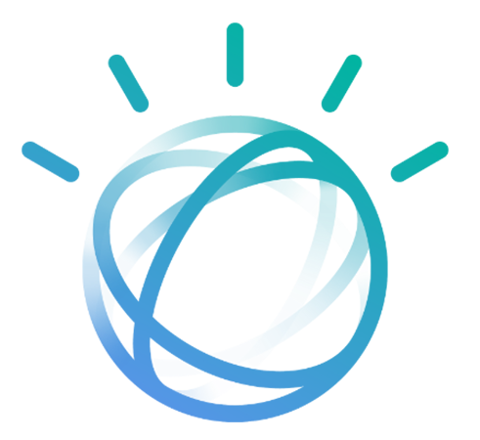
¿Que hace un CSM?
Introducción General

Slide 4
Apoyar la experiencia Post Venta
A
Onboard & Deploy
Identify and engage the business sponsor, run workshops to identify MVP use cases and install / onboard the offering
E
F
1
Identificar
B
Adopt & Implement
9
10
Drives adoption to help the customer to recognize the full value of their offering by building and executing growth plans
D
8
Validar
Crecer
2
Experiencia Preventa
C
Support & Troubleshoot
Experiencia Post Venta
Support team will inform you about persistent customer issues so that you can reach out and manage the relationship
Cuidado del cliente
3
Calificar
D
Expand
Identify potential upsell and cross-sell opportunities
C
7
Adoptar
E
Renew
6
5
4
Activate early renewal conversations by connecting customers to renewal and sales teams and running retention plans with at-risk customers
B
A
Comprar
F
Advocate
Identify and recruit advocates based on success stories
Notes:
We have spent some time talking about the "post-sales journey"… but what does that mean? Let's take a look at the customer lifecycle that we have on the left hand side here. The phases in grey are considered the "transact phase" - these are the pre-sales phases that are driven by sellers. But the blue portion of the cycle is the post-sales journey. It consists of three high level stages in the nurture cycle with a customer: adopt, grow and engage.
But let's double click even further to understand the phases of each high level stage. The first phase of the Adopt Stage is Onboard & Deploy - this is also one of the key responsibilities of Customer Success. At this phase, you will be responsible for identifying and engaging business sponsors, running workshops to identify MVP use cases and installing and configuring the offering for the customer. In phase B, Adopt & Implement, you will drive adoption to help the customer recognize the full value of their offering by building and executing growth plans. Both sections A and B will look different depending on what type of CSM you are - but we have many trainings, playbooks and assets in place to make you feel confident and comfortable to drive these key interactions with your customers.
You will not be heavily involved in phase C, Support & Troubleshoot. Let me be clear – you will not chase down tickets and solve small problems. That responsibility still lies with the Support team. You should be working on architectural structure and focusing on the customer experience to proactively to avoid systemic issues, but as we all know, issues will arise. When a customer has persistent issues with support that undermine their experience, the CSM will step in to mitigate the negative impact on the relationship.
Phase D, Expand, is a phase that we are really excited about for customer success. You are so close to your customers - from the relationships with stakeholders to their business priorities and architecture needs. This puts you in a unique position to identify expansion opportunities. How can our other offerings help this customer achieve their goals? You will identify these upsell and cross-sell opportunities and pass Customer Success Qualified Leads to Sales.
Though you will not be responsible for taking a customer through their renewal contract, you will help to ensure that their renewal happens by activating early conversations and connecting renewal and sales teams to the customer. In the case of an at-risk customers, you will run retention plans to try to keep them involved with their offerings.
Finally, you will be creating customer advocates in phase F, Advocate. By building strong relationships with your customers and giving them a positive experience, we know that you will create advocates that champion IBM both internally at their own company and externally with others. We can't wait to hear all your success stories!

Slide 5
Customer Success Manager
MISION
ROL
Nuestro principal objetivo es garantizar que nuestros clientes obtengan el máximo valor de sus productos adquiridos.
Conocer el estado As - Is del cliente para apoyarlo en su Roadmap To - Be.
Informar a los clientes de los eventos y programas.
Compartir las guías de instalación.
El CSMs no reemplaza:
Ventas: los clientes seguirán trabajando con su equipo de ventas para redactar contratos o resolver problemas de facturación u otros problemas administrativos.
Ventas técnicas: los clientes seguirán trabajando con los actuales equipos de ventas de IBM para el ciclo de preventa (identificar, validar, comprar).
Soporte: los clientes deberán trabajar con el equipo de soporte de IBM para resolver los problemas del producto.

Slide 6




Plan Macro
Actividades generales - SUGERIDAS
Sesión presentación casos de uso
Sesión específica CP
Sesión de descubrimiento
Estructuración MVP
Build out
Welcome Kit
Sesión
general CP
TBD
2 horas
1 hora
1 hora
Interactuar a través de múltiples MVP, perfeccionar las soluciones hasta lograr el resultado de negocio establecido
Escalar el entorno de producción y las aplicaciones
4 horas
TBD
1 hora
Sesión de trabajo en la que participant areas de innovación, estrategia, arquitectura, operaciones orientado al proceso de modernización de aplicaciones
Establecimiento de roadmap de casos de uso identificados, priorización
Definición de alcance técnico, session de recap.
Explicar el alcance completo de la solución
Etapa temprana de identificación
Recursos
Acceso portal
Escalamientos
Entrenamientos
Presentación alcance de funcionalidades sobre el producto.
Cliente
Notes:
Ojo con las demos porque están enfocadas a TI, como hacer demo para ambientes TELCO???
Incluir assessment …
Alienarlo .. Con Hans
Quitar MVP
Build Out …
Pedir la arquitectura que mandó Johnathan. … entender que se envió …
Explotar. --
Funcionalidades adicionales …
Cambiar arquitectrua monolitica a contenerizada

Slide 7
Actividades – Estado del arte
Actividades Proactivas
Actividades Reactivas
Motivadores del cliente
Stakeholders (Funcionales y de TI)
Planes estrategicos
Iniciativas propuestas y en curso
Indicadores claves a nivel de procesos de negocio y a nivel de TI
Versión, Plataforma, instalado por, (en nube /on premise)
Identificación de areas de oportunidad/Casos de uso/MVP
Soluciones de IBM instaladas Vs Licenciamiento utilizado.
Versiones/Obsolescencia
Charlas nuevas versiones
Apoyo escalamiento casos de soporte
Creación solicitud nuevas ideas/funcionalidades

Slide 8
¿Que es un Cloud Pak?
Introducción General

Slide 9









¿Qué son los Cloud Paks?
Acelere los resultados habilitando flujos de trabajo automatizados, inteligentes y seguros
Complete integrated solutions
Aplicar AI en el negocio con Watson
Entender el lenguaje de los negocios y código
Explicar los resultados de la IA y generar confianza
Automatizar la IA que construye IA
Construido sobre una Plataforma híbrida abierta
Construye una vez y despliega donde sea
Plataformas líder en Linux, contenedores y Kubernetes
Ecosistema de Código abierto más rico
IBM Cloud Paks
Data
Business Automation
Watson AIOps
Integration
Network Automation
Security
IBM public cloud
AWS
Microsoft Azure
Google Cloud
Private
IBM Z IBM LinuxOne IBM Power Systems
End points
IBM CP4 Watson AIOps / © 2023 IBM Corporation
9
Notes:
IBM Cloud™ Paks son soluciones de software en contenedores para empresas que ofrecen una forma abierta, más rápida y más segura de mover las principales aplicaciones de negocio a cualquier cloud..
CP – software preintegrado y portable que puede correr en cualquier lado, La portabilidad para las soluciones de IBM significa que están construidas para ejecutarse en cualquier entorno de nube híbrida. Pueden ejecutarse en una infraestructura local, en una infraestructura de nube híbrida.
Soluciones certificadas y seguras,
Los IBM Cloud Paks se ejecutan donde se ejecute Red Hat® OpenShift® y están optimizados para maximizar la productividad y el rendimiento en Red Hat OpenShift on IBM Cloud
Esta es una tecnología de búsqueda de inteligencia artificial y búsqueda empresarial que logra analizar nuestros datos para encontrar tendencias y respuestas específicas a nuestras preguntas, facilitando así la toma de decisiones y acelerando procesos

Slide 10
¿Que hace el Cloud Pak for Watson AIOPs?
Introducción General

Slide 11






Simplifica la gestión de operaciones
Identificar con precisión los problemas emergentes (y resolverlos con base en información previa)
Conseguir que los incidentes se asignen correctamente, con contexto
Diagnosticar rápidamente los problemas en entornos dinámicos y complejos
a
a
Conectar, observer e ingestar
Reducir los incidents y el ruido
Obtener contexto relevante
Colaborar
Automatizar acciones de remediación
Watson AIOps / © 2020 IBM Corporation

Slide 12
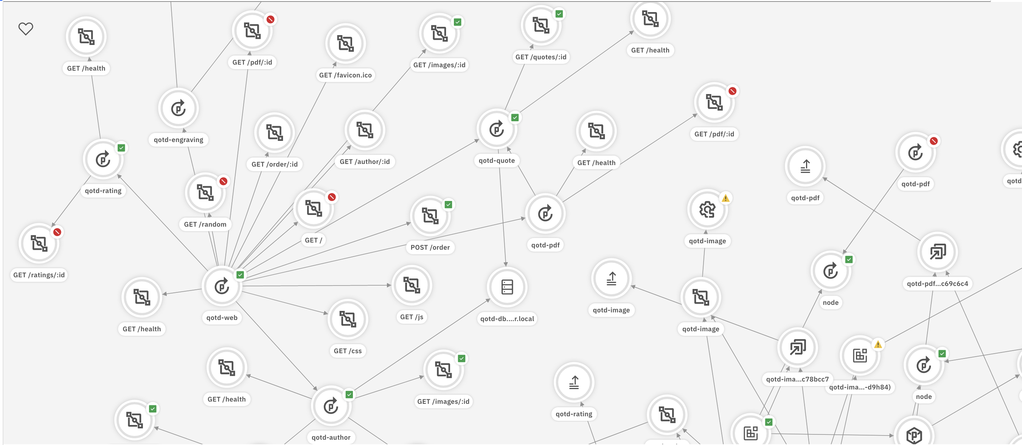














Comprehensive AIOps approach to Real Business Outcomes
Multi-Domain Data Ingest
Informed, Actionable Insights
Augment Ops
Together Application +
Ops teams…
Automated Data Ingest
Analyze & Enrich Data
Trustworthy Actions
Take Actions
Change Tracking
Anomaly Detection
Event Processing Correlation & Enrichment
Fault Localization
Blast Radius
Probable Cause Analysis
Story Creation
Assure Application & Service performance
Accelerate rates of change
Free staff from toil
Reduce support tickets by up to 70%
Unstructured
Contextual side-launch
Act Manually (with a click)
Semi | Full Automation
Pipelines & Workflows
Explainability
Collaboration Integration
CI/CD
Logs
Tickets
Structured
Events / Alerts
Metrics
Topology / Changes
2022 IBM Corporation
Notes:
Achieving real business outcomes requires continuous optimization you can operationalize.
Here’s how we do that….
Pulls in existing data from your environment in the most automated manner `
(Automated deployement Agent for Instana, 30 Min API feed for Turbo, 100s of on the shelf connectors for CP4WA and new connector gateway)
Analyse & enrich the data collected - that’s where AI start to enter in action.
Instana provides context especially with the Autotrace, Turbo Maps the relationships between the application, platform, and infrastructure – wherever those apps run, CP4WA leverages event grouping and the best Topology tool in the market to tie datasources together.
Trustworthy actions derives from applying different AI Models to the enriched data. Instana provide the best Observability AI Models, Turbonomic leverages its unique supplychain AI Model to understanding how do applications get what they need to perform and provide resourcing decisions continuously based on real-time demand. CP4WA has a 30 of AI Models to apply to the most various data sources – bridging data sources to provide the best Incident Reduction, Probable Root Cause of an issue and Blast radius.
These actions can then be automated – Most AIOps domain specific vendors miss this essential step to automate and drive actual value to the business/
Your teams automate / execute those actions as suits your business, processes, and app architectures
Bridge operational gaps that hinder the adoption of automation!
The business outcomes structured around 3 market defined areas (Observability, Cloud & Infrastructure Optimization, and Pro-active Remediation (or Incident resolution).
Transition:
How does is IBM materializing this AIOps value creation for the business
_________
The Total Economic Impact™ Of IBM Turbonomic Application Resource Management Report by Forrester https://www.ibm.com/account/reg/signup?formid=urx-51403

Slide 13




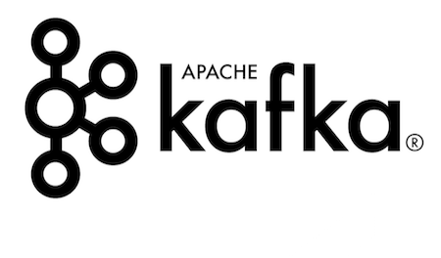
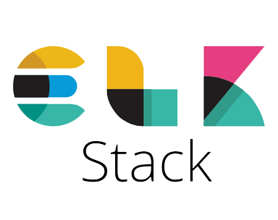
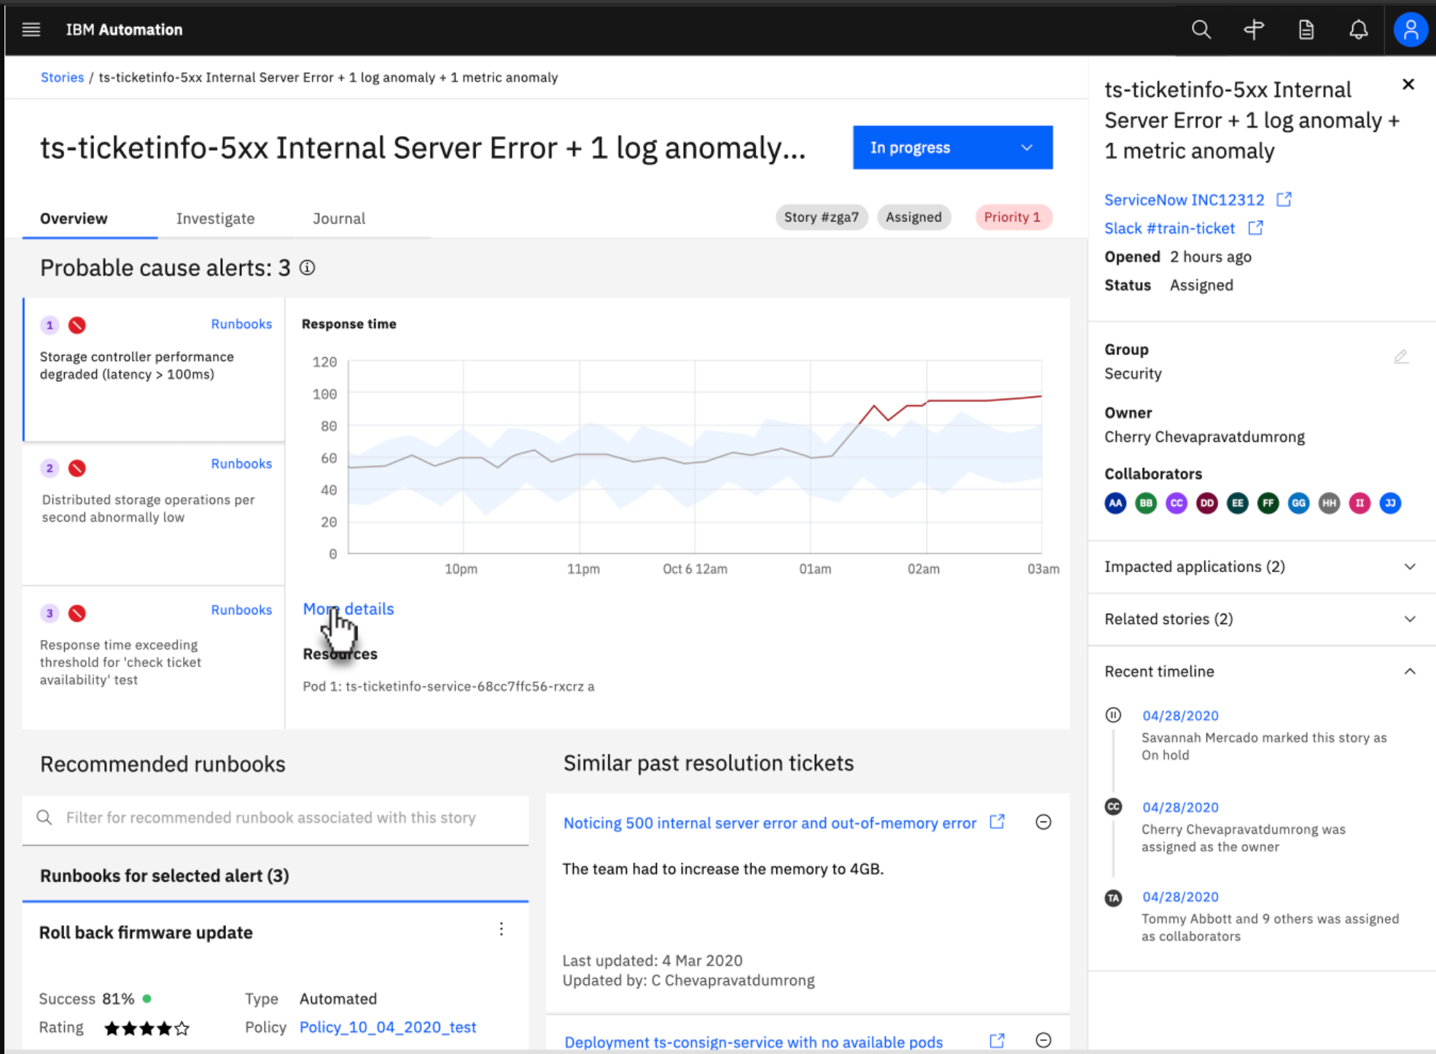

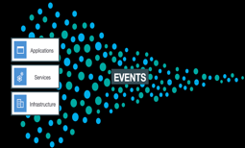
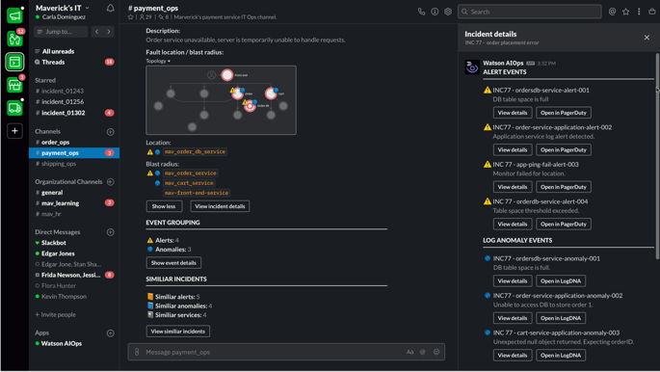
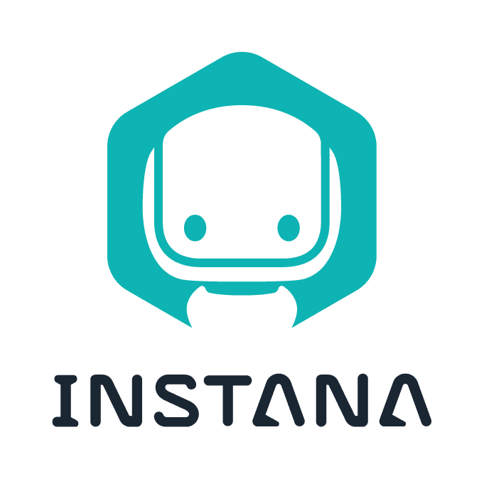
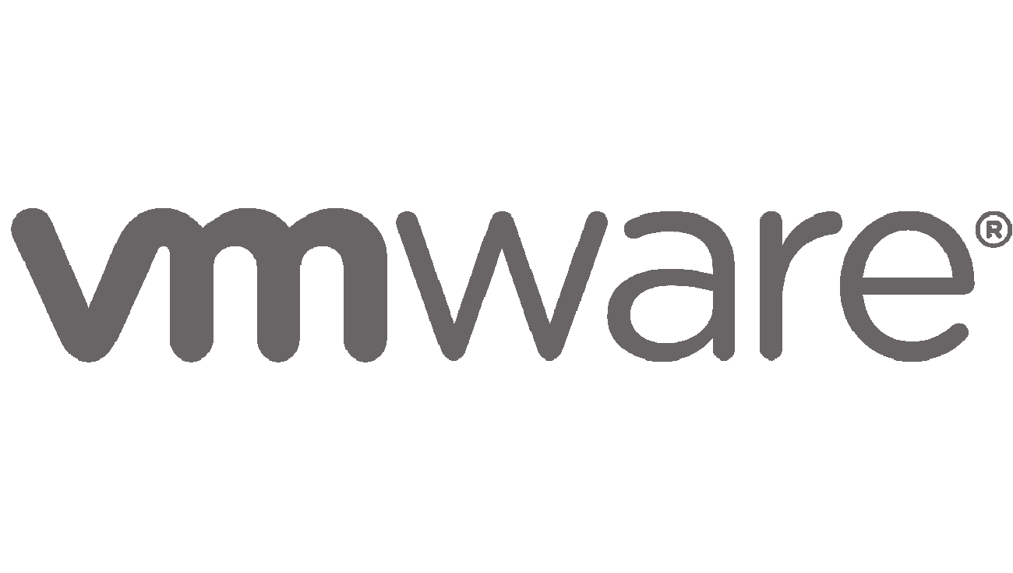

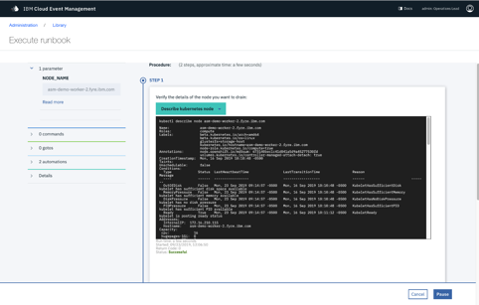


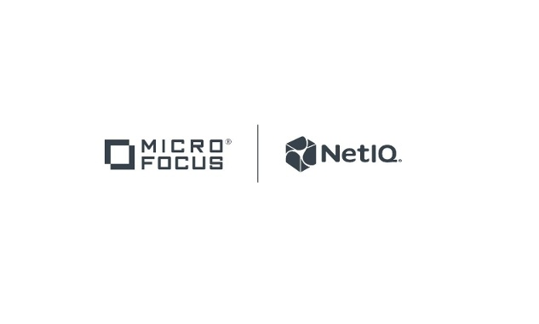
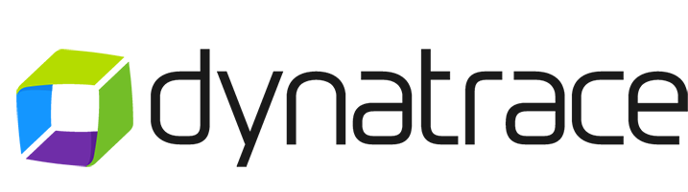




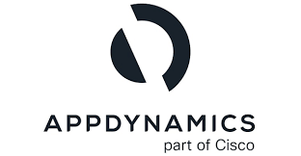




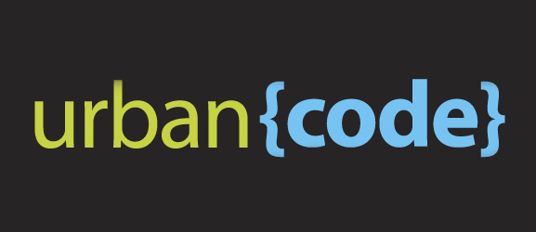


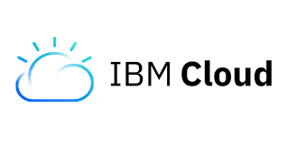





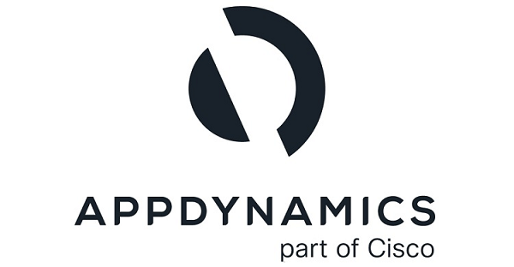







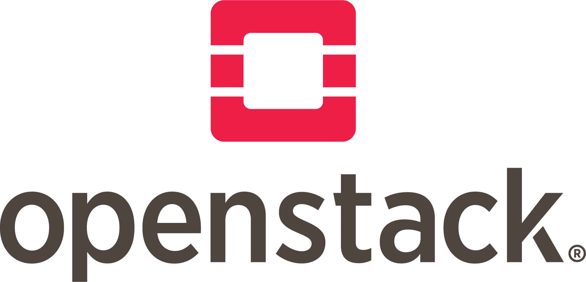
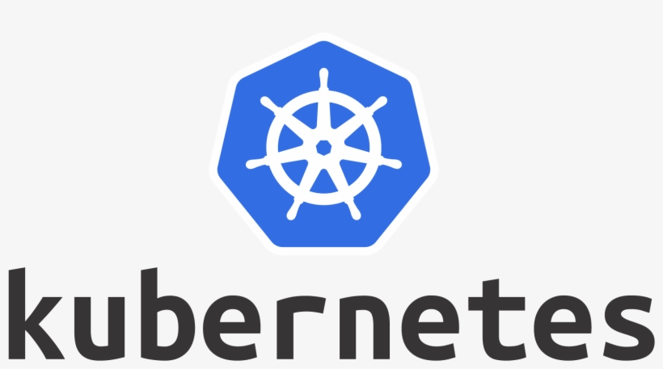
Implementing AIOps with IBM
Logs
Natural Language
Processing
Add Guidance
Tickets,
Knowledge Bases
Collaborate using Console, ChatOps & Tickets
Logs
Tickets
Log Analytics
Reduce Noise & Prioritize
Guide & Resolve
Anomalies
Metrics
Automate
Event Processing
Events
Events / Alerts
Metric
Analytics
Notification
Anomalies
Associate to Topology
Metrics
Topology
Store
AI Manager
Topology
Metric Manager
Add Probable Cause
Environment Topology
Event Manager
infrastructure Automation

Slide 14

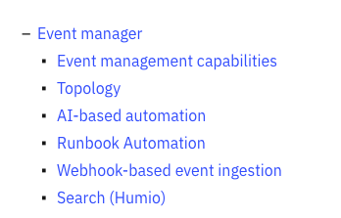
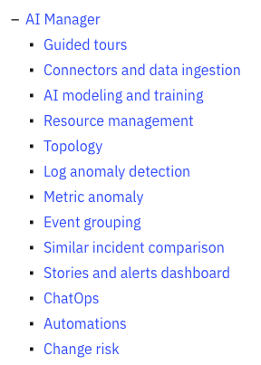
Heartbeat of a proactive resolution (V-3.6)
Event Manager
AI Manager
Infrastructure Automation
Discover state of environment
Optimize performance and utilization of environment
Notes:
Goal of this slide: Present a high-level discussion of Cloud Pak for Watson AIOps’ four major components. Discuss in this order: Event Manager, Metric Manager, Infrastructure Automation, then AI Manager. In this slide deck, each component is presented in its section with an accompanying case study.
IBM Cloud Pak for Watson AIOps deploys AI across clients’ IT toolchains to help them resolve IT incidents quickly. Using data collected from ITOps environments, Cloud Pak for Watson AIOps alerts operations teams to problems, identifies root causes, and recommends solutions for mission-critical applications. The heartbeat of Cloud Pak for Watson AIOps includes four major functional components:
Event Manager
Metric Manager
Infrastructure Automation
AI Manager
Event Manager
The Event Manager component of Cloud Pak for Watson AIOps can ingest event data from various sources: alerts, anomaly events, deployment configuration items, or topology. After ingestion, a set of AI/ML (artificial intelligence/machine language) algorithms is applied to provide the event grouping. Event grouping can be done based on topology, temporal pattern analytics, or rules. The event grouping capabilities work collaboratively to help operations teams reduce trouble tickets, diagnose problems quickly, reduce MTTR (mean time to resolve), and save operational costs. Event Manager is responsible for providing better insights into events which then provides event reduction.
Metric Manager
The Metric Manager component has capabilities to detect and predict anomalies. It uses custom-built models based on client data along with predictive insights technology to perform metric analysis.
Infrastructure Automation
The Cloud Pak for Watson AIOps Infrastructure Automation capabilities are focused on providing proactive management through automated actions. This component can discover resources such as virtual machines (VMs), clusters, and many others, and then automate provisioning with shell scripts and Ansible playbooks. Through integration with Turbonomic, it can optimize the utilization of application resources.
AI Manager
AI Manager can automatically parse logs of any arbitrary format and analyze structured and unstructured data. Log anomalies are detected using Statistical Baseline and Natural Language Processing (NLP) technology. Predictive insights are generated with Real-time Statistical Model (RSM). Putting all this AI together can help to reduce the mean time to diagnose (MTTD) of IT operation incidents.

Slide 15
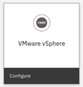
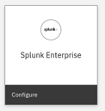
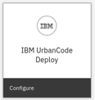
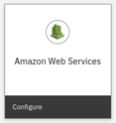
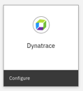
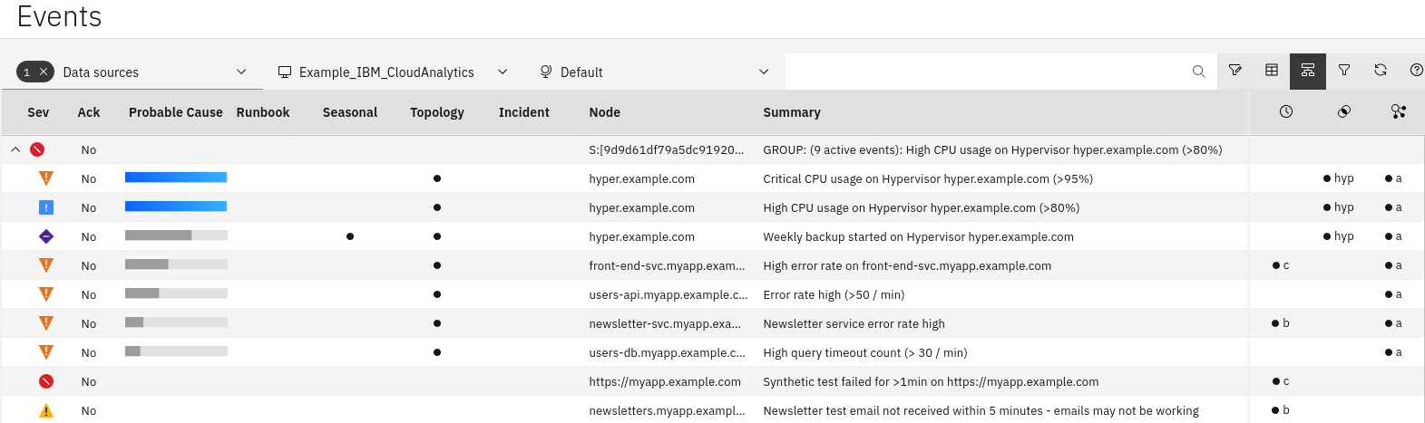
Event Manager
Acquire events from any source
Industry leading event grouping
Reduce noise and incidents with AI and machine learning
80% time-savings via fewer false positives, per Forrester
+ hundreds more sources
Notes:
Goal of this slide: Present Cloud Pak for Watson AIOps Event Manager capabilities.
Cloud Pak for Watson AIOps Event Manager monitors the health and performance of IT and network infrastructure across local, cloud, and hybrid environments. It incorporates event management capabilities and uses real-time alarm, alert analytics, and broader historic data analytics. Event management gives clients actionable insights into the performance of services and their associated dynamic network and IT infrastructures. Event management helps organizations collect, consolidate, and correlate events and topology data from virtually any source.
Event Manager can automatically combine multiple grouping capabilities to group events by the incident, thus reducing pages and trouble tickets. Event grouping is done by topology, scope, and event analytics, thus providing better insights into the events which then provides event reduction. As an example: a Forrester study at an IBM client’s environment noted how they were able to reduce events by up to 80% through the Event Manager’s event grouping capability.
The Event Manager component is powered by IBM Netcool Operations Insight and installed with the IBM Netcool Operations Insight operator. Its features are accessible from the separate IBM Netcool Operations Insight user interface console but installed as part of Cloud Pak for Watson AIOps.

Slide 16
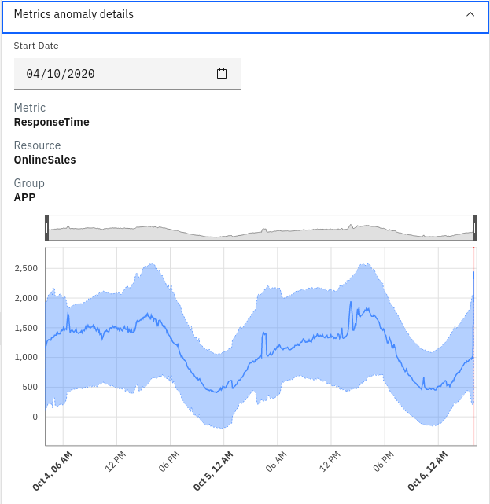
Metric Manager
Predict and preempt problems with AI and ML capabilities
Time series performance metric analysis
Anomaly detection and alerting
AI driven model selection
Notes:
Goal of this slide: Present Cloud Pak for Watson AIOps Metric Manager capabilities.
Cloud Pak for Watson AIOps Metric Manager has capabilities to identify emerging issue. With its Predictive Insights technology, IT operations can become proactive and avoid incidents. It uses custom-built models based on client data and is both robust, and non-parametric.
Metric Manager automatically determines which algorithms to use, what their parameters should be, and validates them to ensure they are best-set and can learn daily weekly, monthly patterns. It builds up to seven anomaly detection analytical models per metric (instance of a KPI) and uses them to detect problems. Predictive Insights discovers three types of advanced mathematical relationships:
Correlation
Granger Causing (similar to a time-lagged correlation)
Related Events (things that tend to be anomalous at the same time)
These mathematical relationships are calculated across 500,000 metrics every 5 minutes, or 750,000 metrics every 15 minutes. Significant changes in behavior are detected independent of the baseline that is indicative of common IT problems.

Slide 17
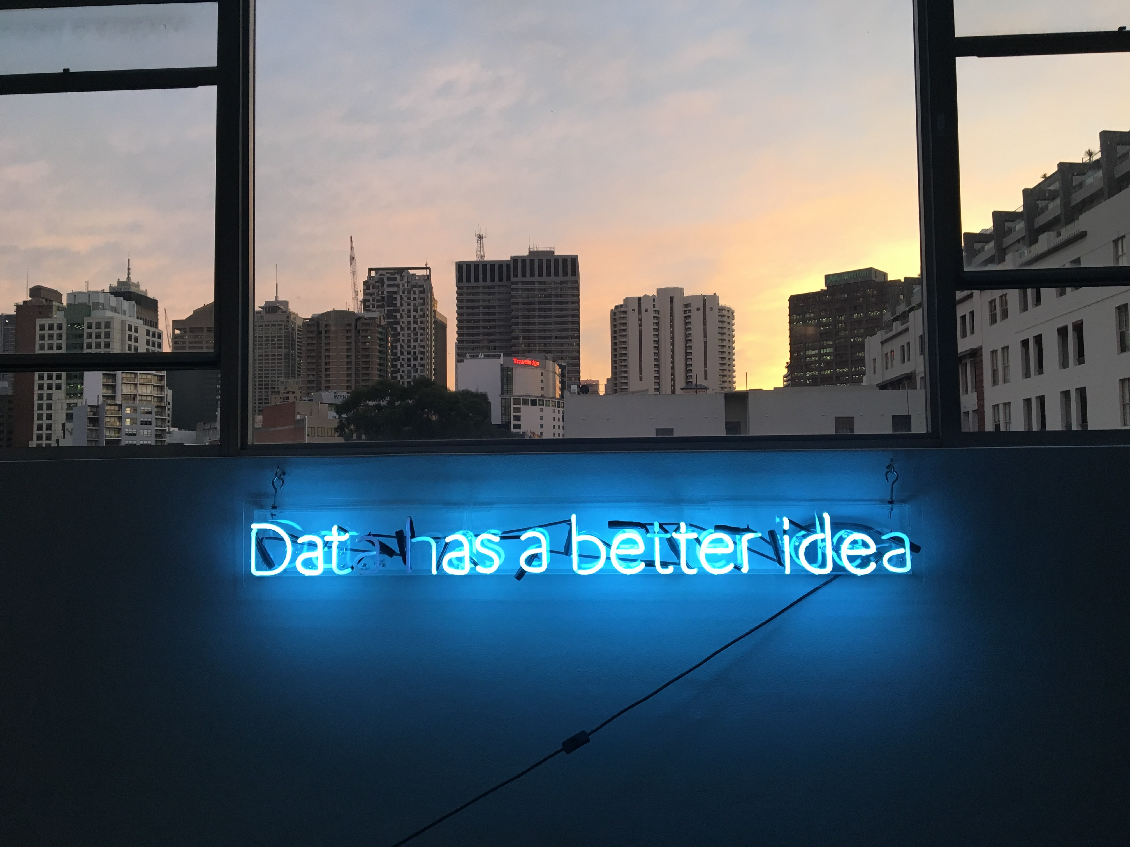
AI Manager
Analyze structured and unstructured data
Detect log anomalies using Statistical Baseline and NLP
Reduce mean time to diagnose (MTTD) incidents
Automatically parse logs of any arbitrary format
Predictive insights with RSM
(modelo estadístico en tiempo real)
Notes:
Objetivo de esta diapositiva: Presentar las capacidades de Cloud Pak for Watson AIOps AI Manager.
Cloud Pak for Watson AIOps AI Manager recopila información de todo el entorno de TI de un cliente, como las aplicaciones, la infraestructura en la que se ejecutan y los sistemas de red que las soportan. A continuación, utiliza estos datos para descubrir información oculta e identificar las causas de los incidentes. El uso de estos datos para entrenar modelos conduce a un mejor descubrimiento de eventos y a una comprensión más precisa de la topología de un cliente. Con este conocimiento avanzado de su topología, los clientes pueden determinar con precisión dónde se producen los incidentes (localización de fallos) y cuál es el alcance de su impacto (radio de explosión). Cuando AI Manager detecta incidentes potenciales, crea una historia sobre el incidente. A continuación, utiliza un entorno ChatOps, como Slack o Microsoft Teams, para notificar, actualizar y proporcionar a los equipos de operaciones de TI posibles soluciones casi en tiempo real, lo que permite a los equipos de los clientes automatizar tareas con una toma de decisiones clara y abierta mediante IA.
AI Manager emplea técnicas avanzadas de IA para el descubrimiento de eventos y la comprensión de la topología de un cliente. Statistical Baseline puede detectar anomalías en los registros en cuestión de minutos. Cuando se combinan con el procesamiento del lenguaje natural (NLP), trabajan juntos para detectar problemas al tiempo que reducen el ruido para el equipo de operaciones de TI. El modelo estadístico en tiempo real (RSM) proporciona información predictiva de forma inmediata sin necesidad de formación fuera de línea. Sólo se necesitan 30 minutos de datos para entrenar el modelo. RSM reduce considerablemente el tiempo necesario para detectar anomalías en los registros.

Slide 18
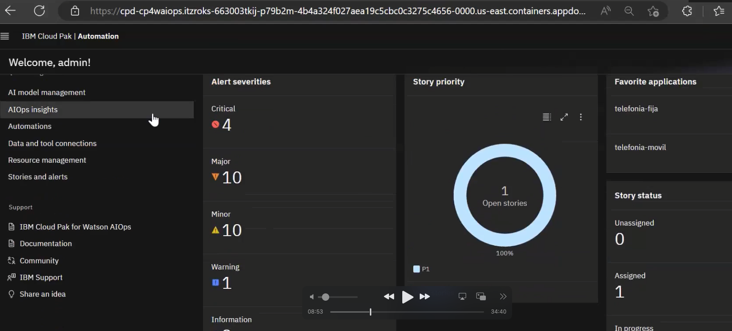

Slide 19
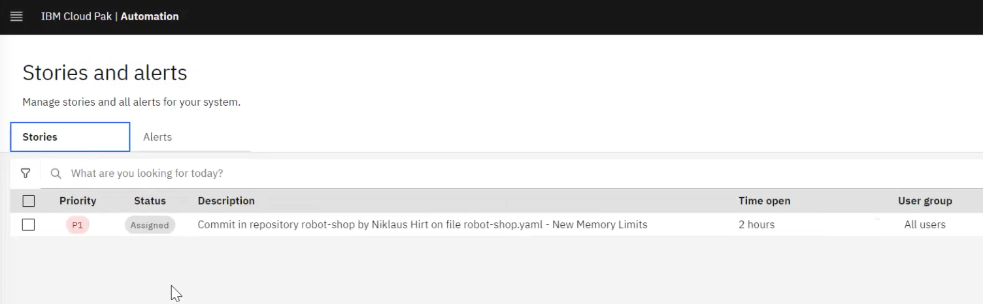
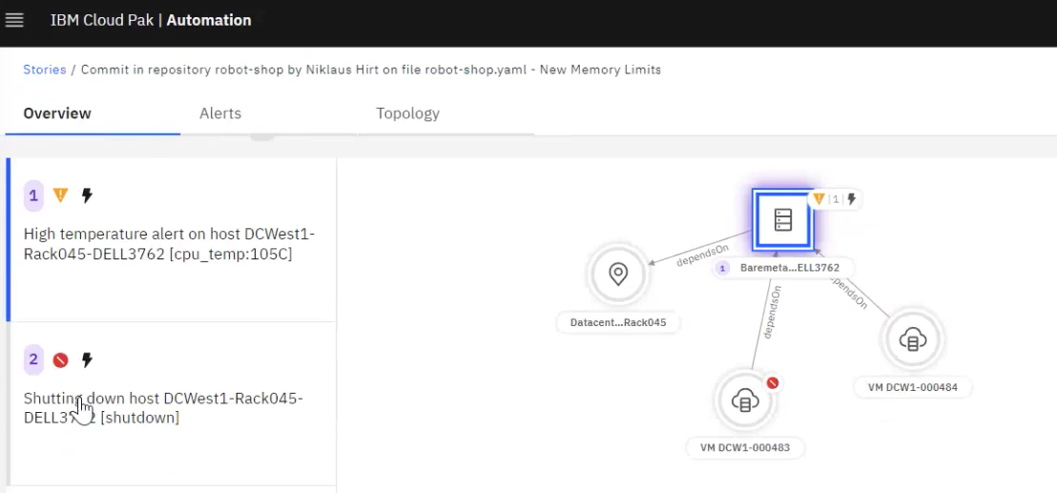
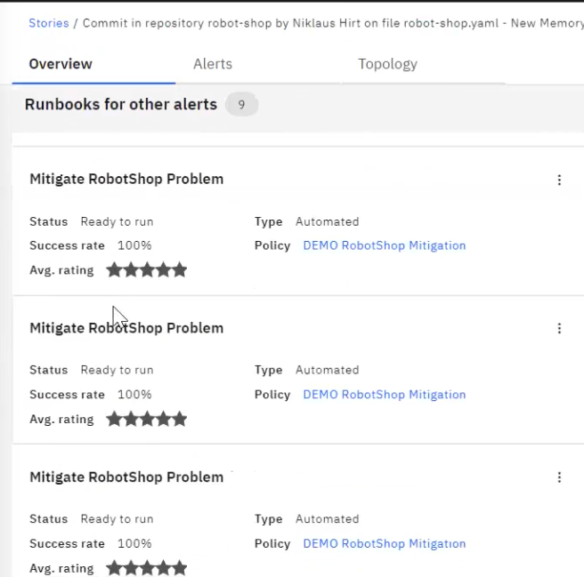
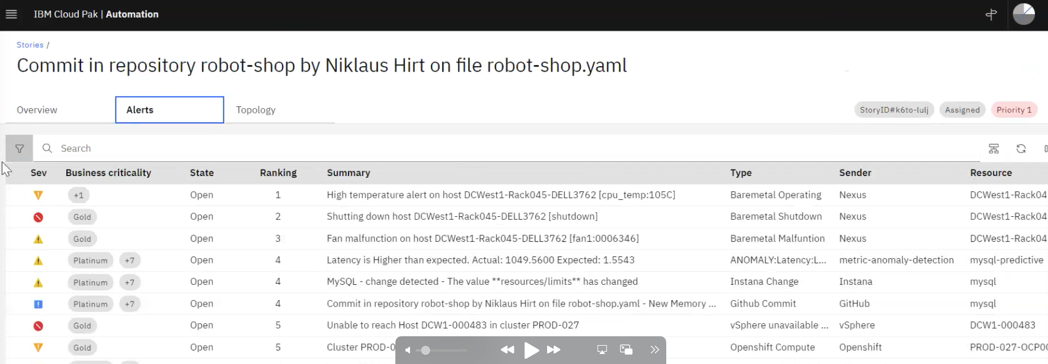

Slide 20
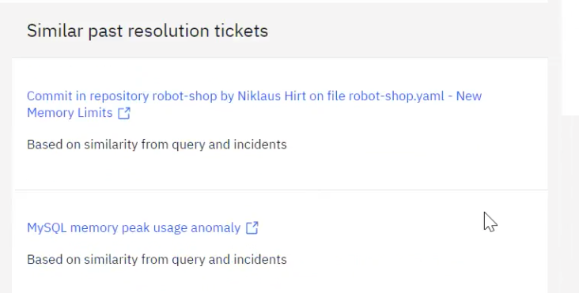
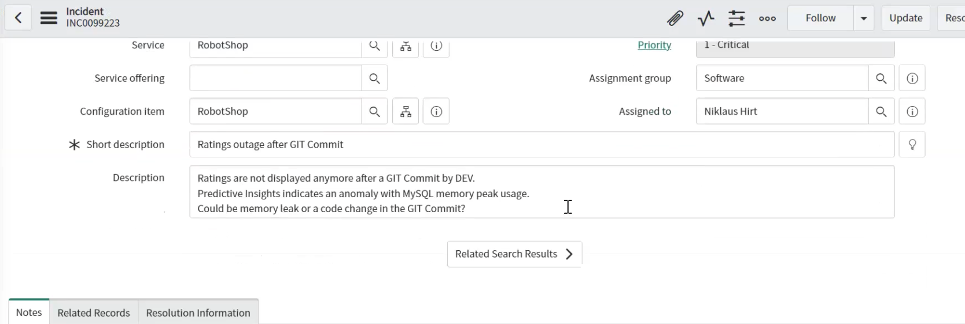

Slide 21

Infrastructure Automation
Proactive management through automated actions
Discover latest state of environment
Enable self-service provisioning with templates
Automate provisioning with scripts or playbooks
Notes:
Goal of this slide: Introduce Infrastructure Automation capabilities.
Cloud Pak for Watson AIOps Infrastructure Automation capabilities are focused on providing proactive management through automated actions. These capabilities include:
Discovery of resources such as virtual machines (VMs), clusters, datastores, hypervisors, cloud instances, images, security groups, networks, and availability zones
Automated provisioning with shell scripts or Ansible Playbooks
Creation of placement rules for multiple clouds and VMs
Setting governance and compliance policies across clouds and VMs
Chargeback reports for VMs
Enabling self-service provisioning using templates
Disaster recovery (via integration with Spectrum Protect Plus)
Optimizing application resources via integration with Turbonomic

Slide 22
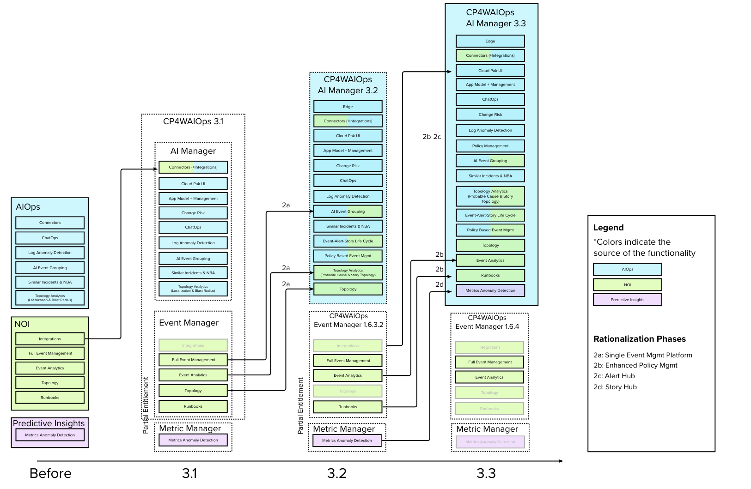
Looking Back…
Notes:
Looking back…
A lot changed but the focus satyed the same – have a modern scalable foundation to bring clients value.
We want to
show clients their entire estate
Bring down MTTR by reducing noise, automatically provide context and insights to understand the problem, provide guidance on how to fix it, and automations to do so and avoid it next time.

Slide 23
¿Que estamos haciendo en CLARO?
Introducción General

Slide 24
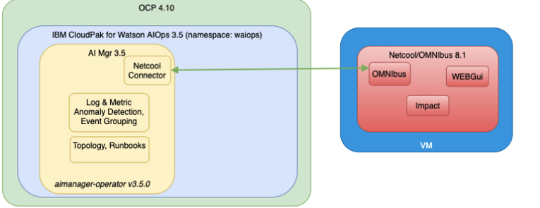

Slide 25
Arquitectura: AI MANAGER
LOAD BALANCER
DNS
DHCP
Firewall
…
Watson AIOps Event Manager
Storage: Red Hat Openshift Data Foundation
Bootstrap
4 vCPU 16 RAM
Master
16 vCPU 32 RAM
Worker
16 vCPU 36 RAM
Worker
16 vCPU 36 RAM
Worker
16 vCPU 24 RAM
Worker
16 vCPU 24 RAM
Master
16 vCPU 32 RAM
Worker
16 vCPU 36 RAM
Worker
16 vCPU 36 RAM
Worker
16 vCPU 24 RAM
v.4,8
Master
16 vCPU 32 RAM
Worker
16 vCPU 36 RAM
Worker
16 vCPU 36 RAM
Red Hat Openshift Data Foundation
Intel x86 farm
= entregado por el cliente

Slide 26
“Automation & Event Analytics” – Estimación de Hardware Mínimo
Proyecto | Description | Node | #VMs | #Cores Virtual | #Mem (GB) | Internal Disk 1 (GB) | Internal Disk 2 (GB) | Antiaffinity (yes/no) | PVs (GB)
Event Analytics, Automation & Topology Management | Red Hat OpenShift | Masters | 3 | 16 | 32 | 120 | 0 | yes | 0
 | Event Manager | Workers | 6 | 16 | 36 | 120 | 0 | Yes | 0
 | Red Hat ODP | Workers | 3 | 16 | 24 | 120 | 0 | no | 3150
Event Management | Event Manager (Gw) | Virtual Machine | 1 | 8 | 32 | 100 | 0 | no | 0
Event Management
Fuente: Hardware requirements for IBM Cloud Pak for Watson AIOps Event Manager - IBM Documentation
Categoría | Recurso | Capacidad
Event rate throughput | Steady state events per second | 50
 | Burst rate events per second | 500
Topology sizing | Approximate Resources | 5000000
Metric Mgmnt System Size | Number of metrics | 100000
Environment options | Minimun metric granularity | 5 mins
 | High availability | Yes
Estimation & deployment assumptions:
Red Hat ODP considera 3 nodos, los cuales estarán dedicados al almacenamiento por lo tanto 3150 = 12,5 TB totals de storage efectivo (ROW)

Slide 27
¿Dónde encuentro información?
Introducción General

Slide 28
¿Qué recursos del cliente están disponibles para los Cloud Paks?
Cloud Paks en ibm.com | Documentación de IBM | Comunidad de Soporte IBM
Cloud Pak for Applications | IBM Cloud Pak for Applications Documentation | Cloud Pak for Applications
Cloud Pak for Automation | IBM Cloud Pak for Automation Documentation | Cloud Pak for Automation
Cloud Pak for Data | IBM Cloud Pak for Data Documentation | Cloud Pak for Data
Cloud Pak for Integration | IBM Cloud Pak for Integration | Cloud Pak for Integration
Cloud Pak for MCM | IBM Cloud Pak for Multicloud Management | Cloud Pak for MCM
Cloud Pak for Security | IBM Cloud Pak for Security | Cloud Pak for Security
Cloud Pak System | IBM Cloud Pak System Software | Cloud Pak System
Cloud Pak for Watson AIOps | IBM Cloud Pak for Watson AIOps | Cloud Pak for Watson AIOps
Cloud Pak for Network Automation | IBM Cloud Pak for Network Automation | Cloud Pak for Network Automation

Slide 29


Centro de conocimiento de IBM
Los clientes pueden explorar la documentación oficial del producto de IBM.
- Documentación sobre tendencias
- Documentación de IBM Cloud Paks
- Documentación destacada
- Documentación de recursos
IBM Documentation

Slide 30
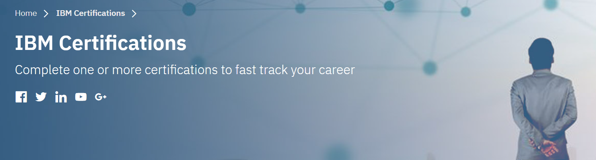
La misión del Programa de Certificación Profesional de IBM es: - Proporcionar un método fiable, válido y justo para evaluar las habilidades y conocimientos. - Desarrollar una comunidad mundial de profesionales certificados altamente cualificados que recomienden, vendan, den servicio, den soporte y/o utilicen productos y soluciones de IBM.
IBM Certifications
V
https://www.ibm.com/training/certification/C9003300

Slide 31
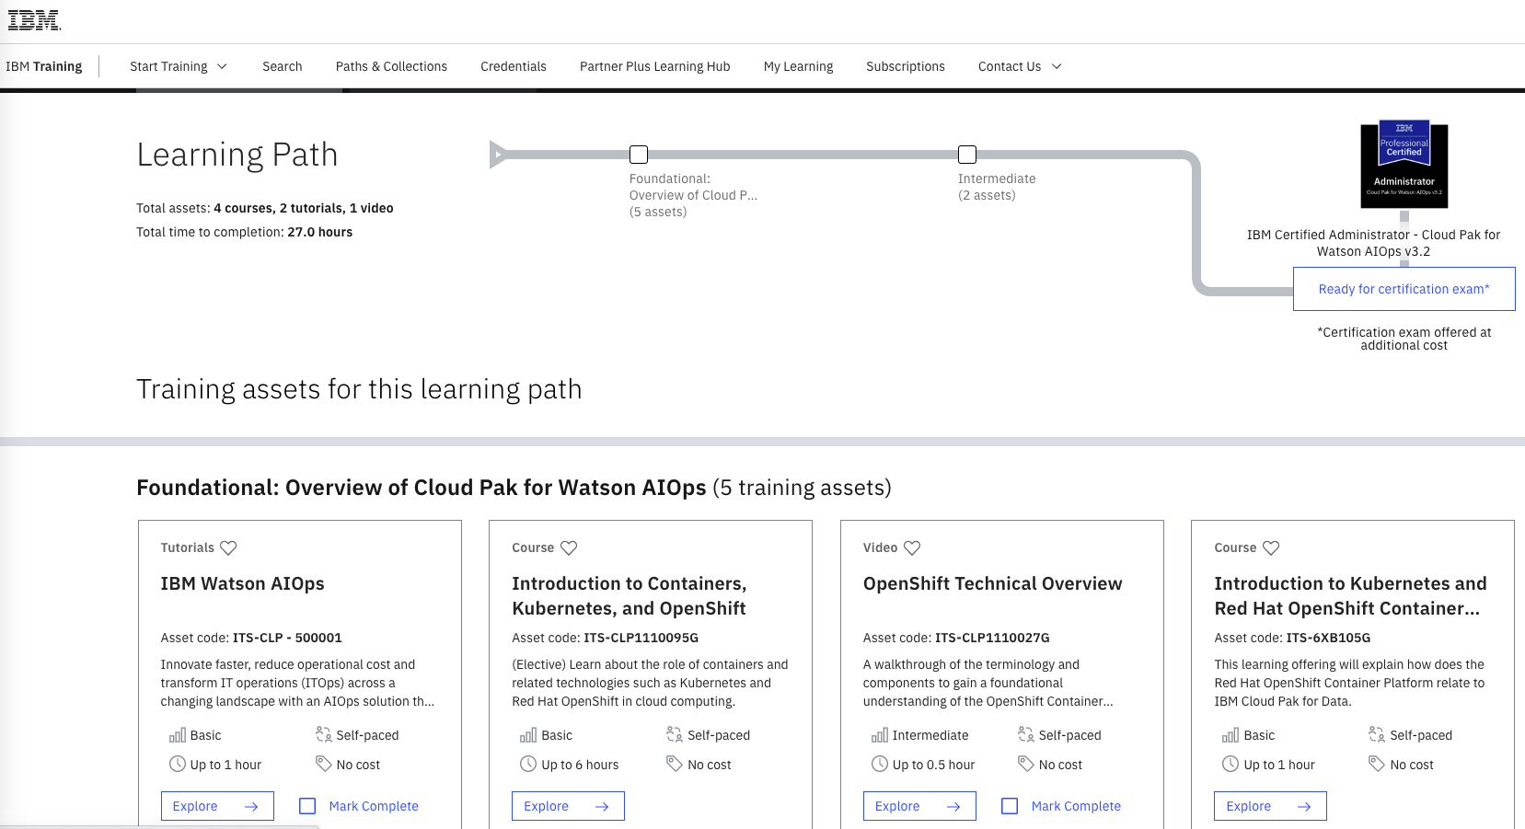
https://www.ibm.com/training/path/ibmcloudpakforwatsonaiops

Slide 32
Notes:
This slide requires no speaker’s notes.

